Slide 1
Managing Successful Change

Slide 2
The Change Process
Awareness
Buy In
Skills
Desire
Resources
Action plan
Change

Slide 3
Awareness
Buy In
Skills
Desire
Resources
Action plan
Confusion
Awareness
Buy In
Skills
Desire
Resources
Action plan
Sabotage
Awareness
Buy In
Skills
Desire
Resources
Action plan
Anxiety

Slide 4
Awareness
Buy In
Skills
Desire
Resources
Action plan
Resistance
Awareness
Buy In
Skills
Desire
Resources
Action plan
Frustration
Awareness
Buy In
Skills
Desire
Resources
Action plan
Treadmill

Slide 5
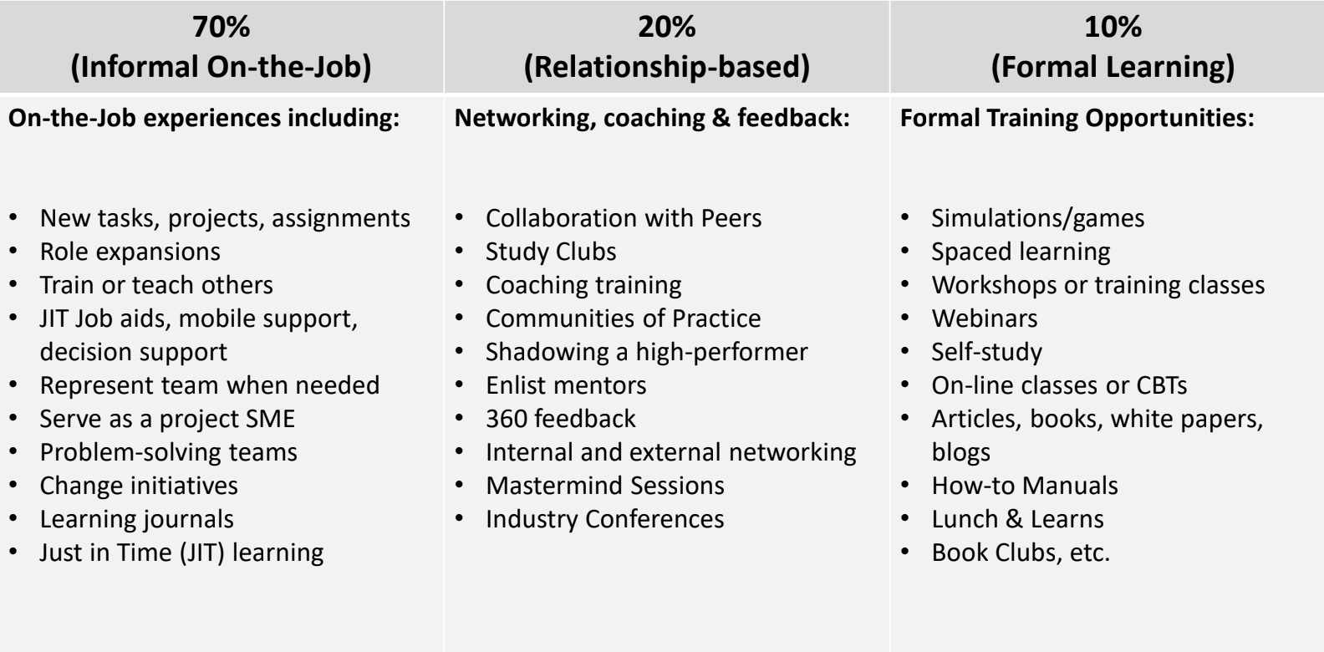

Slide 6
Keys to Change in Behavior
1. Realize that people need time to grieve for old process
2. Make sure you follow the 6-step change process
3. Keep in mind 70% is on-the-job training
4. Put in place accountability systems
5. Be Open to change

Slide 7
“Train people well enough so they can leave, treat them well enough so they don’t want to.”
Richard Branson

